Slide 1

K0PA MISSION NOISE
10-December -2020
MUSASHI AUTO PARTS INDIA PVT. LTD.

Slide 2
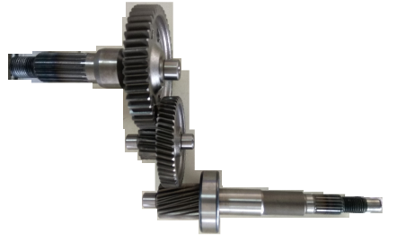
K0PA-Mission Noise
Subject ：- NOISE REPORTED AT HMSI
■Contents of report
 | Contents | Page | Cum Time Sec
1 | Problem and Primary Causes | 3 | 10
2 | Case 1.Teeth Damage | 4~7 | 80
3 | Case 2.OBD, Lead and Profile | 8 | 10
4 | Lead and Profile Study and Optimization | 9~11 | 60
5 | OBD Study and Optimization | 12~13 | 40
6 | Recent N2 Noise parts report | 14 | 20
 | Total |  | 220 Sec
Model: K0PA
Gear Comp Final
a.Gear Final
b.Shaft Final
Gear Comp Counter
a.Gear Counter
b.Shaft Counter
Shaft Drive
Primary Focus
Gear Counter
Shaft Drive
Date ： 2020/Dec/10
Reported ： Musashi Auto Parts India Pvt. Ltd
Approval
Check
Issued
Umasankar
Satoshi/Prashanth
Anoop

Slide 3
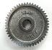
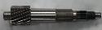
PROBLEM AND PRIMARY CAUSES
Case1
GC
SD
TTCE NG
TEETH DAMAGE
Reported From Customer
OK
Mission Noise
a.LEAD AND PROFILE
To be Studied for Improvement
Case 2
TTCE OK
b.OBD
TTCE(Tooth-To-Tooth Composite Error): Measured error between adjacent teeth of the part gear using a master gear.
Nicks or Damages in the teeth will show up as tooth-to-tooth error
Gear Counter Teeth Damage is First Focus

Slide 4
CASE 1-TEETH DAMAGE
PROCESS FLOW
MATERIAL RECIEVING
TURNING1
TURNING2
BROCHING
HOBING
Outflow
GRT
SHOT BLASTING.
HT
JIG LOADING
SHAVING
Occurrence
Occurrence
ASSY. SC & GC
DISPATCH TO HMSI
Teeth Damage Occurrence and Outflow area Identified

Slide 5
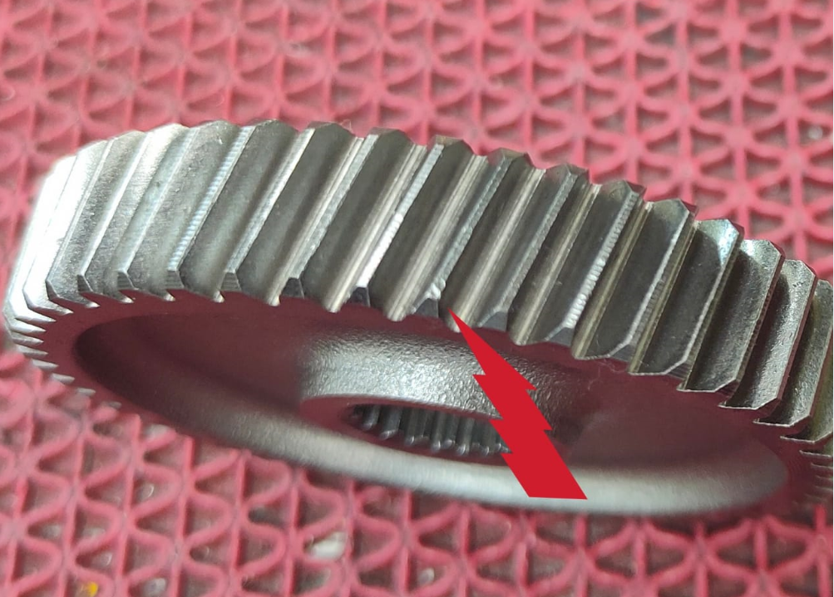
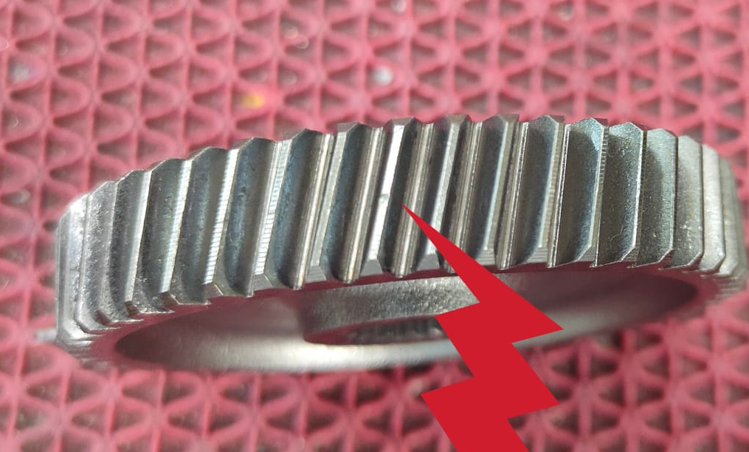
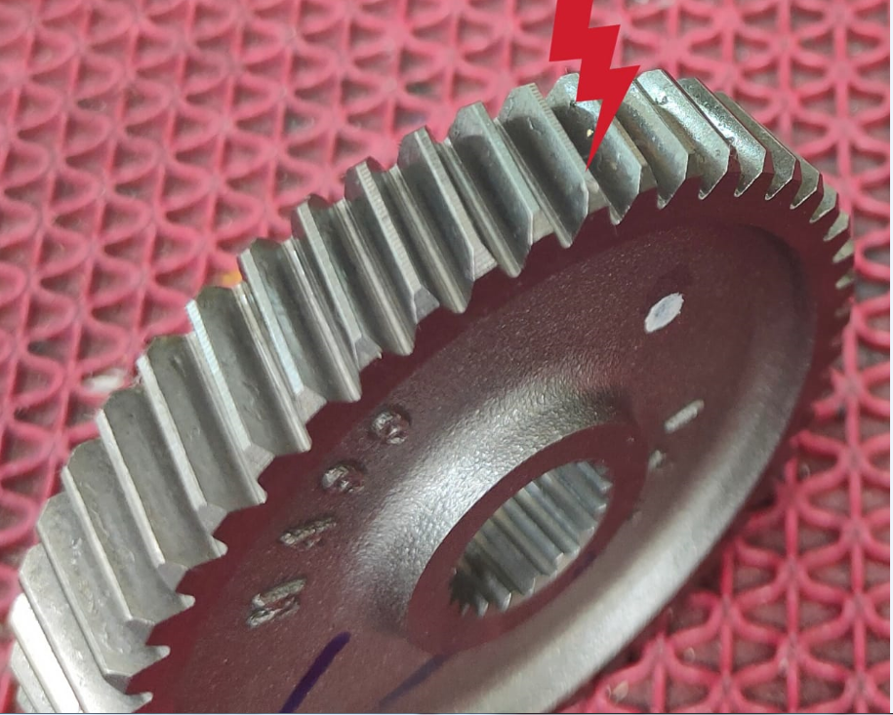
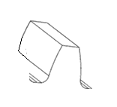
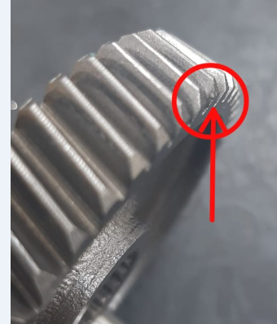
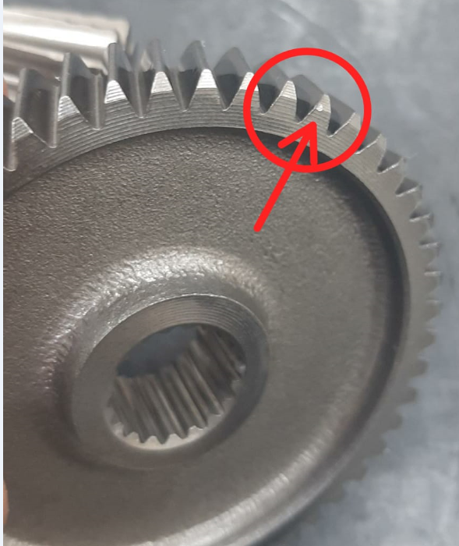
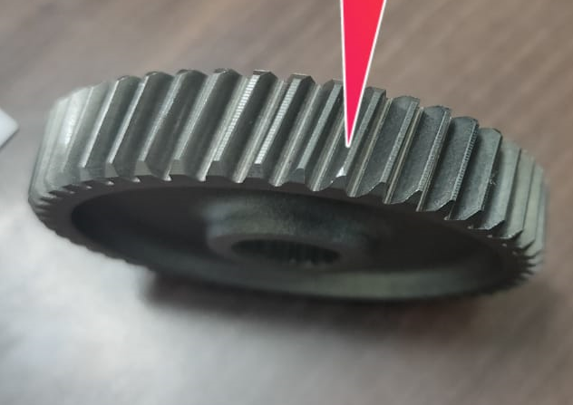
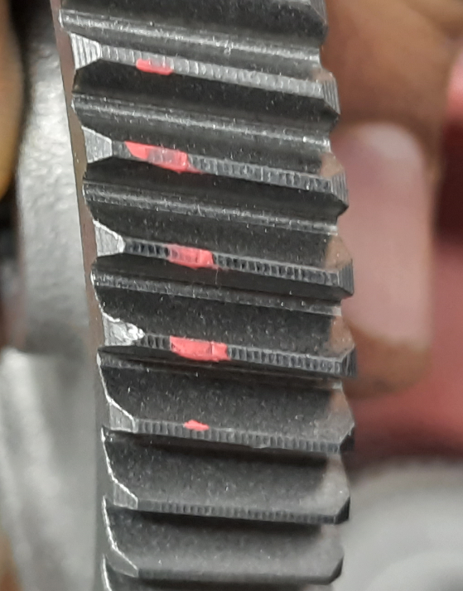
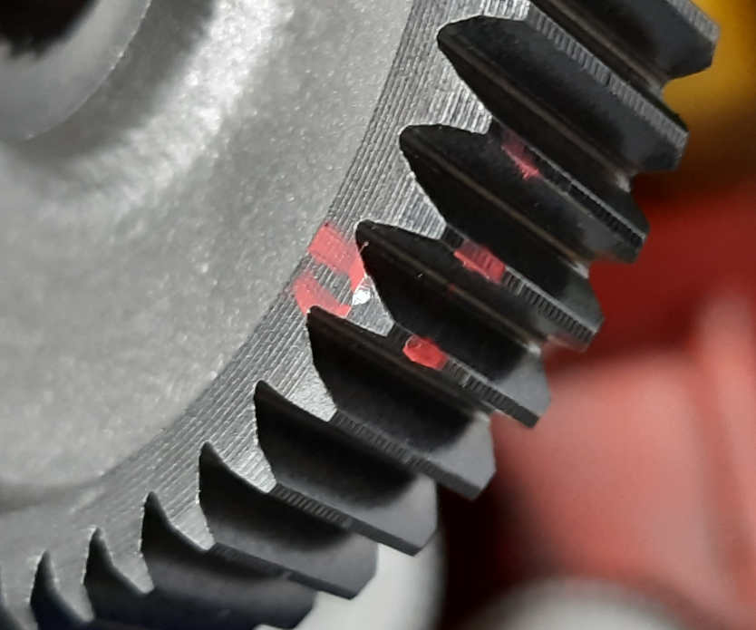
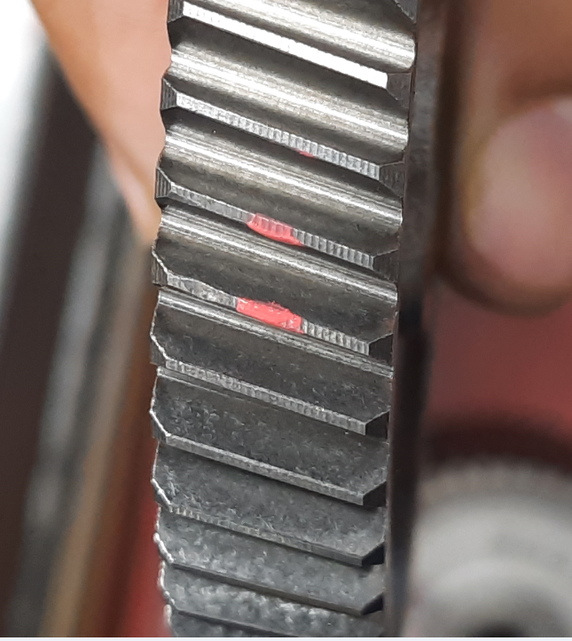
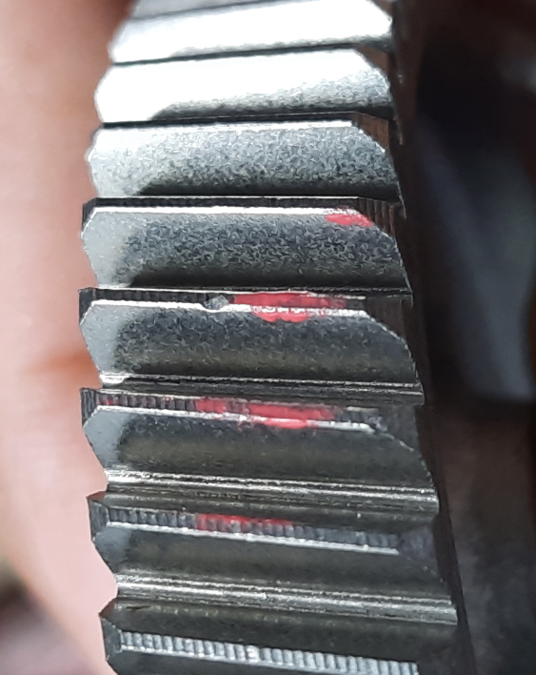
TEETH DAMAGE-DAMAGE COMPARISON
Customer Reported Dents:-
Dent Location
TTCE
SLNO | TTCE (0.016 Max) | Hard/Soft
1 | 0.024 | Hard
2 | 0.035 | Hard
3 | 0.026 | Hard
4 | 0.028 | Hard
5 | 0.030 | Hard
Tip Area
Semitopping
Bottom Edge
Inhouse Reported Dents:-
Dent Location
SLNO | TTCE (0.016 Max) | Hard/Soft
1 | 0.045 | Soft
2 | 0.072 | Soft
3 | 0.050 | Hard
4 | 0.046 | Hard
5 | 0.081 | Soft
Tip Area
Teeth OD
Semitopping
Higher TTCE part not Flowing to Customer
Soft Dents Majorly detected at Inhouse
Lower TTCE Damages to be Analysed

Slide 6
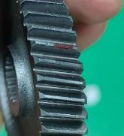
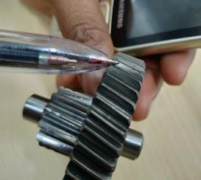
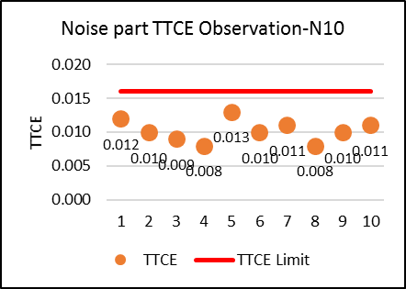
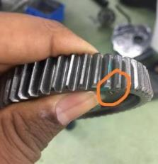
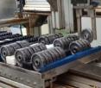
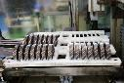
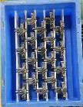
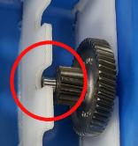
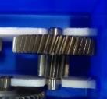
TEETH DAMAGE-OBSERVATIONS AND ACTION
OBSERVATIONS
Conclusion:
TTCE OK parts also Create Noise.
Small Nicks at tip Not Detected at MAP ID.
Nature of Damage: Damage on OD which bulged to Flank
TTCE OK Observed on Some Noise parts even though Small Nick Visible
ACTIONS
Root Cause | Action | Before | After | Resp | Status
Part Touching at Unloading Pallet of Shaving due to pallet worn out and Broken | Output Pallet Design Changed to avoid breakages and Part to part Hit. (L1, L2 Implemented) |  |  | Hubli/Gaurav | Ο
Parts Slipping from Slots in Bin and Possible to Touch Each other when Transport | Immediate: NG Bins Identified and Removed From System Permanent: 100% Inspection of Bin Before Issue to Line |  |  | Krishna | Ο
Part 4
Part 1
Part 2
Part 3
Part 4
Part 1
Part 2
Part 3
Pallet
Firm holding of Parts with new Designed Pallet
Touching Corners/OD When unloaded part Tilts
Occurrence Action Completed

Slide 7

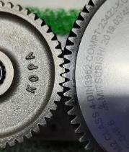
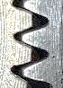
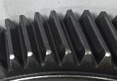
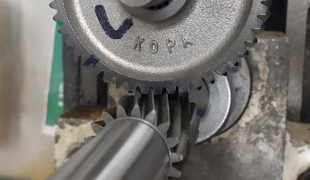
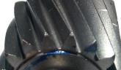
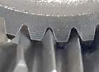
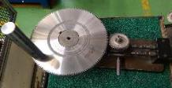
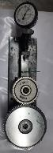
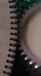
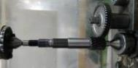
TEETH DAMAGE-OBSERVATIONS AND ACTION
OBSERVATIONS
Observation at Noise Parts:
TTCE Below 0.007 also create Noise at Vehicle (0.016 max)
Suspect:
Detection Mechanism
Verification:
Vehicle Condition Simulation with SD
Phenomenon:
Master gear Design cannot Replicate Mating Part Condition
1
2
1
Conclusion:
Master Gear Design Improvement to be done
2
Small Nick at Tip escapes from Master Gear
Small Nick also create noise effect due to Contact Pattern
ACTIONS
 | Root Cause | Action | Resp | Status
Outflow | 1.Existing Master gear Design not able to detect Small Nicks | Immediate: Additional Roll Testing added with Mating Part established on Temporary basis. Permanent: 1.Master Gear Design Improvement to be Done (First round of Discussion with maker over) | Giridhar Narendra | Ο Feb-21
 | Small nicks Observed on the parts which is showing TTCE OK in GRT | Sense/Feeling Based Detection Started and Suspected parts Reworked through Burnishing process and Re-Verified through GRT | Giridhar | Ο
Burnishing Process
Burnishing will take out all fine Dents on teeth Tip.
GRT With Master Gear
GRT With Mating Part
Outflow Weakness Identified and Addressed

Slide 8
EFFECTIVENESS
GRT with SD
Re- Analysis and Actions
Issue Reported even after Actions
Weakness Analysis Started

Slide 9
GAP ANALYSIS
Weak Point Identification-Outflow
Focus: GRT with Mating Part
 | 4M | Weak Area | Root Cause | Action | Status
❶ | Man | Detection Level By Operator not enough | Skill Level not sufficient as New method of inspection | Limit Sample Introduced Training Conducted with Limit Sample Ishiwara Test Conducted Dedicated Manpower Decided for Inspection | ○
❷ | Machine | Different Reading between Two GRT | Top Center Play observed at One GRT (Play:0.025) | Top Center play arrested (0.006) | ○
❸ | Material | - | - | - | -
❹ | Method | Awareness Level not enough among the Inspectors | Existing Standardization weak as New Method Of Inspection | Inspection Startup Check Sheet Provided Mating Height level Standardized | ○

Slide 10
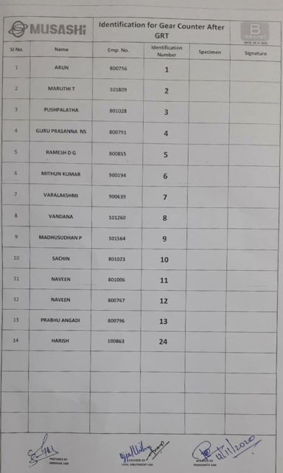
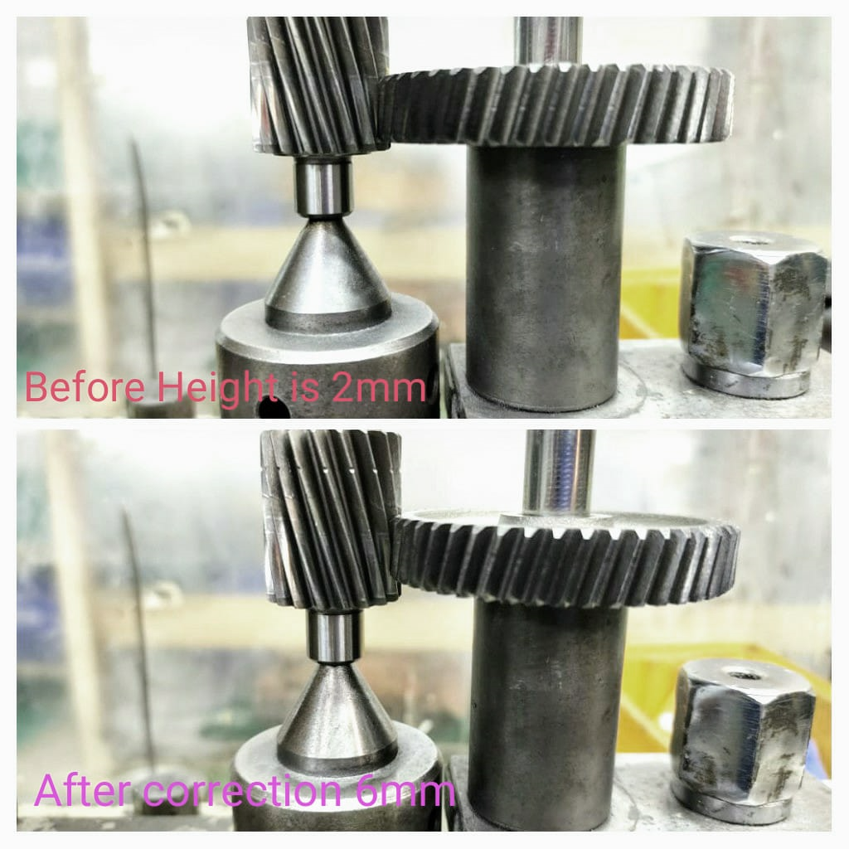
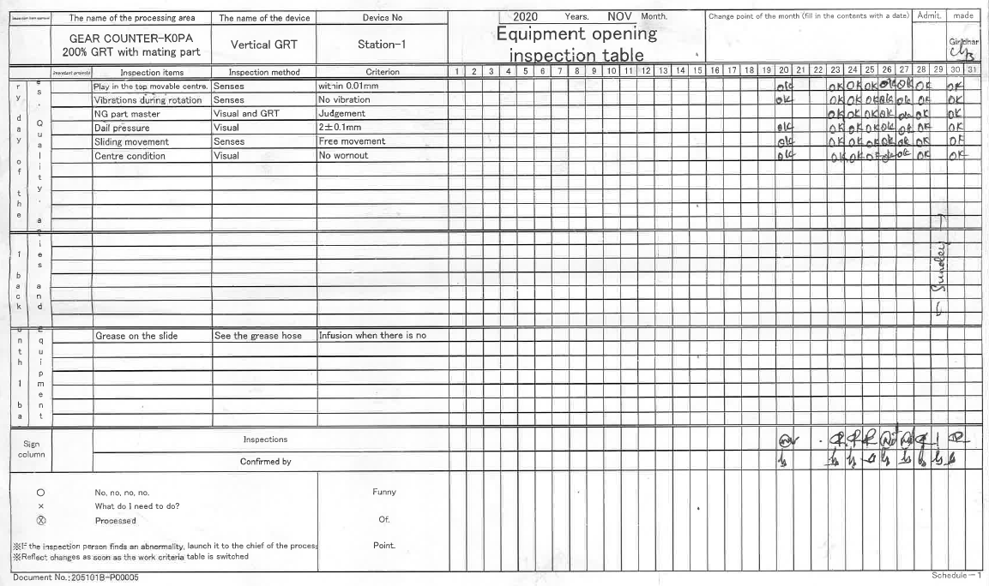
GAP ANALYSIS
EVIDENCES
GRT 1 identified as Problematic and Corrected
Center Play Correction
❶
SUMMARY ISHIWARA
SL | Name | Defective Samples Verified | Correct Judgement | In Correct Judgement | Pass/Fail
1 | Vandana | 6 | 6 | 0 | P
2 | Pushpalatha | 6 | 6 | 0 | P
3 | Naveen | 6 | 6 | 0 | P
4 | Maruti | 6 | 6 | 0 | P
5 | Guruprasanna | 6 | 6 | 0 | P
6 | Prabhu | 6 | 6 | 0 | P
7 | Harish | 6 | 6 | 0 | P
8 | Mithun | 6 | 6 | 0 | P
9 | Ramesh DG | 6 | 6 | 0 | P
10 | Varalakshmi | 6 | 6 | 0 | P
11 | Madhusudhanan | 6 | 6 | 0 | P
12 | Sachin | 6 | 6 | 0 | P
13 | Naveen(767) | 6 | 6 | 0 | P
14 | Arun | 6 | 6 | 0 | P
❷
Play at This Center
Inspectors List
Ishiwara Result
❹
Measuring Hight Standardized to replicate the Situation at Customer.
Before: 2 mm
Initial Start-Up Check Sheet
After: 6 mm
Effectiveness Monitoring Continuously.

Slide 11
GAP ANALYSIS
Weak Area Identification-OCCURRENCE
 | 4M | Weak Area | Root Cause | Action | Status
❶ | Man | Handling practice | Handling awareness among the people reduced as new manpower added to System | Thorough Training Given to Operators with reference to Customer Detected parts and Internal Detected Parts | ○
❷ | Machine | Gear Line: Part to Part Touching at Unloading. (Line 1 and 2) | Gantry Unloading part touches to parts available in unloaded pallet due to Pallet Hight More | Pallet Hight Reduced | ○
 |  | Gear Line: Line 2, Part Drop inside machine | Part Dropping from Part Carrying Pocket at Shaving Unloading Area | Wear out part Replaced Life monitoring started for Replaced part to avoid failure in Future | ○
❸ | Material | - | - | - | ○
❹ | Method | After Shot Blasting: Frequent Trolly Fall down | Trolly wheels Small In Size which Leads to falling | Trolly wheels replaced by Bigger Wheels Dedicated trolly provided for Gear Counter with Identification | ○
Effectiveness Monitoring Continuously.

Slide 12
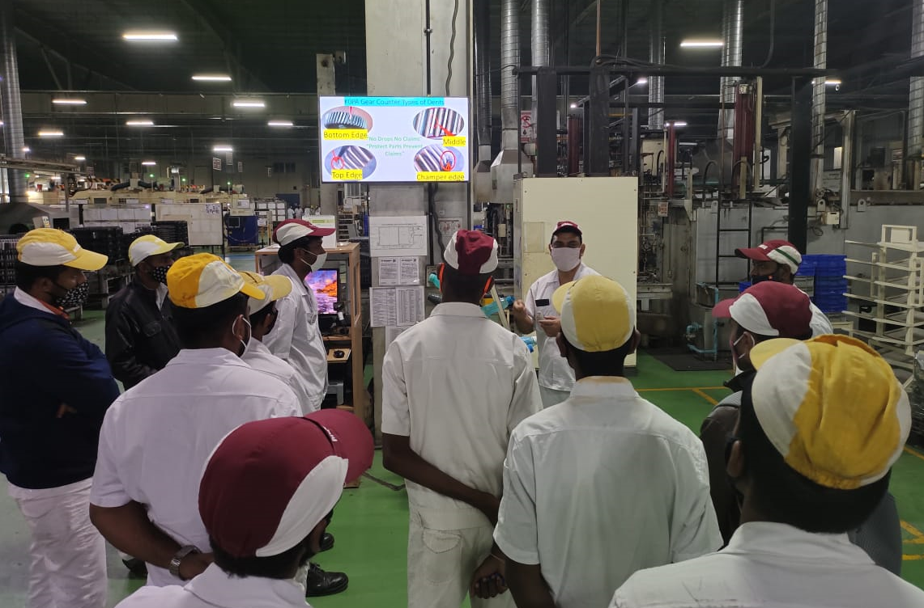
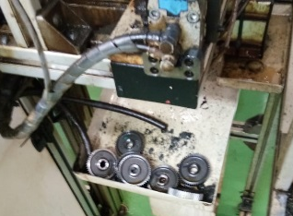
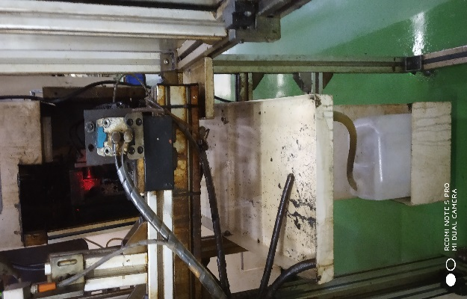
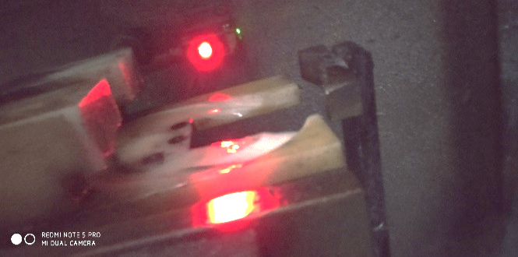
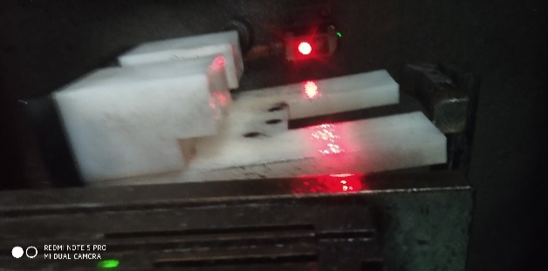
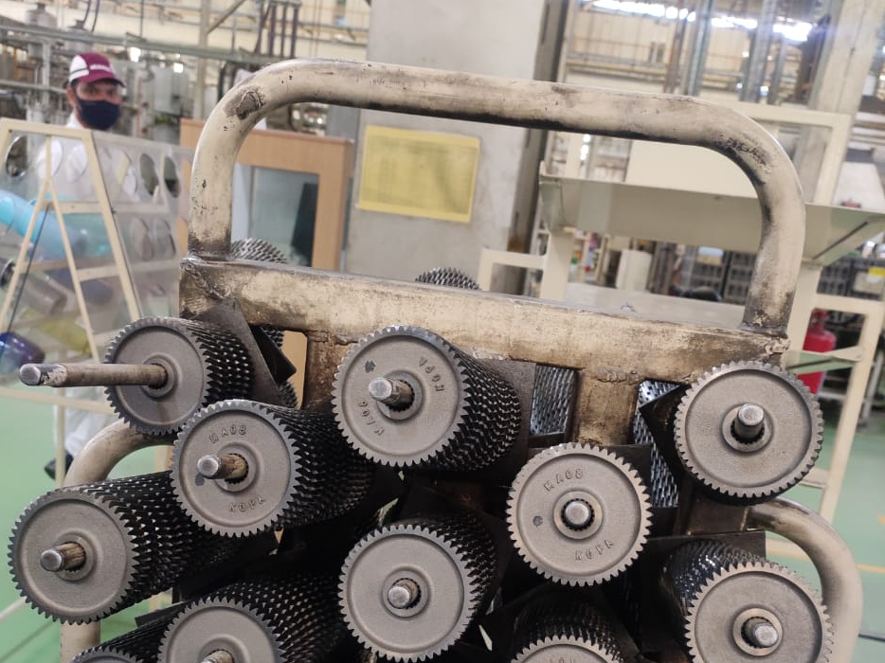
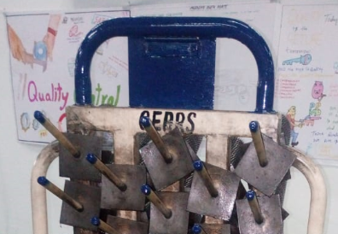
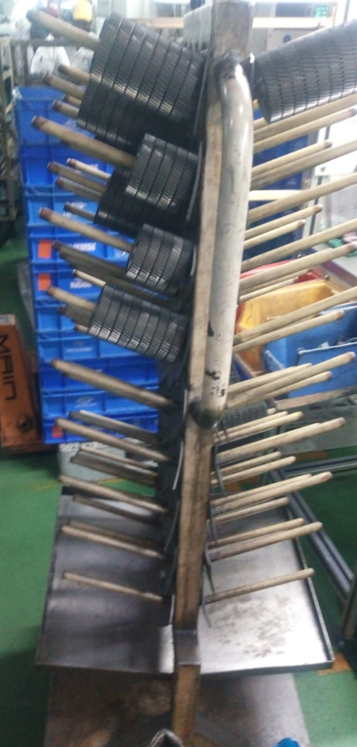
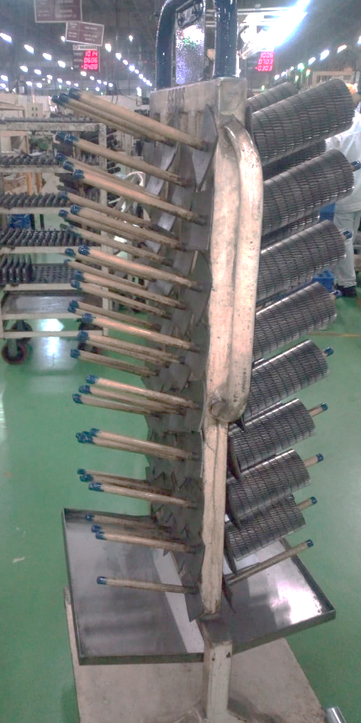
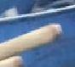
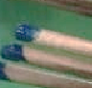
GAP ANALYSIS
EVIDENCES
Before
After
❶
❷
Worn out Unloading Pocket Replaced
Training at Gemba
Before
After
Before
After
❹
Marking made to Avoid overloading
Identification for Gear Counter Dedicated Trolly
Effectiveness Monitoring Continuously.

Slide 13
EFFECTIVENESS
GRT with SD
Actions Completions
Zero Dent Noise issues from 25th Nov
Re- Analysis and Actions
Continuously Monitoring the Effectiveness, Internal and External
Effectiveness Monitoring Continuously.

Slide 14
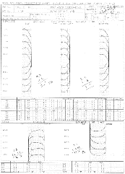
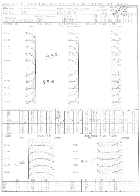
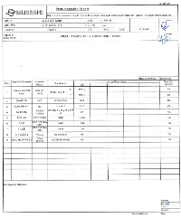

CASE 2-OBD AND LEAD AND PROFILE STUDY
STUDY ON NOISE PARTS
Noise Parts Dimensional Report
Result
Gear Counter
Shaft Drive
Ο
Ο
Ο
Nature wise and Spec wise NO ISSUE OBSERVED
Scope for improvement to be identified from MP monitoring
Ο
FOCUS AREAS FOR NOISE IMPROVEMENT
Lead and Profile- Gear Counter and Shaft Drive
OBD –Gear Counter and Shaft Drive
Lead and Profile and OBD to be Focused

Slide 15
CASE 2- LEAD AND PROFILE STUDY
Lead and Profile Current Situation (Shaft Drive-Regular MP Parts)
Ο
Ο
Parameter | Spec | Min |  | Max
 |  | L | R | L | R
FA | 0~10 | 8.4 | 5.6 | 9.5 | 8.6
TC | 0~4 | 0.9 | 0.4 | 2.6 | 2.2
FH | -10~10 | -3.4 | 1.9 | -2.3 | 6.3
CRN | 0~6 | 2.5 | 2.6 | 3.6 | 3.2
Ο
Ο
All OK
Ο
Lead and Profile Current Situation (Gear Counter-Regular MP Parts)
Ο
Ο
Parameter | Spec | Min |  | Max
 |  | L | R | L | R
FA | 0~10 | 4.5 | 2.5 | 7.4 | 4.3
TC | 0~4 | 1.4 | 1.5 | 3.3 | 2.6
FH | -6~6 | -0.4 | -1.9 | 3.3 | 1.9
CRN | 0~6 | 1.1 | 1.2 | 2.3 | 2.7
Ο
Ο
Lead crowning Improvement scope to be Studied
Gear Counter Lead Crowning to be Improved

Slide 16



CASE 2- LEAD AND PROFILE STUDY
Gear Counter
Shaft Drive
CONTACT PATTERN CHECK
Low CRN
Shaft Drive
Area of Contact
Gear Counter
High CRN
Area of Contact
Lead Crowning Target Optimization to be Considered
Parameter | Improvement Point | Improvement Action | Target | Resp | Status
Lead Crowning (CRN) | Gear Counter Crowning Target to be Optimized | 9 Point studies to be taken and Soft and Hard Target to be Finalized | 20.10.2020 | Hubli/Harish/Anoop | Ο
Gear Counter Lead Crowning level Optimized

Slide 17
CASE 2- LEAD AND PROFILE STUDY
RESULT
Before
After
LH
RH
LH
RH
LH
RH
LH
RH
LEAD CROWNING FOR ALL LINE IMPROVED

Slide 18



CASE 2- OBD
OBD-Comparison
Shaft Drive
Gear Counter
∆
∆
Ο
OK
∆
Improvement Required
Parameter | Scope for Improvement | Action | Target | Resp | Status
OBD | Gear Counter OBD Maintained Mean to USL | Soft Spec Optimized to Achieve Mean Level. (At all lines Implemented) | 30.10.2020 | Narendra/Anoop/Hubli | Ο
OBD Soft Spec Optimized to bring final OBD to Mean Level.

Slide 19
CASE 2- OBD
RESULT
Before
After
Soft Spec
Soft Actual
Final Spec
Final Actual

Slide 20
EFFECTIVENESS

Slide 21
THANK YOU!

